Slide 1
Shaping the Future of Nursing Education through Leadership: Insights from 50 Years in the Field
Theresa M. “Terry” Valiga, EdD, RN, CNE, ANEF, FAAN
Professor Emerita, Duke University School of Nursing
Isabel Maitland Stewart Conference, Nursing Education Alumni Association, Teachers College, Columbia University – May 14, 2021

Slide 2

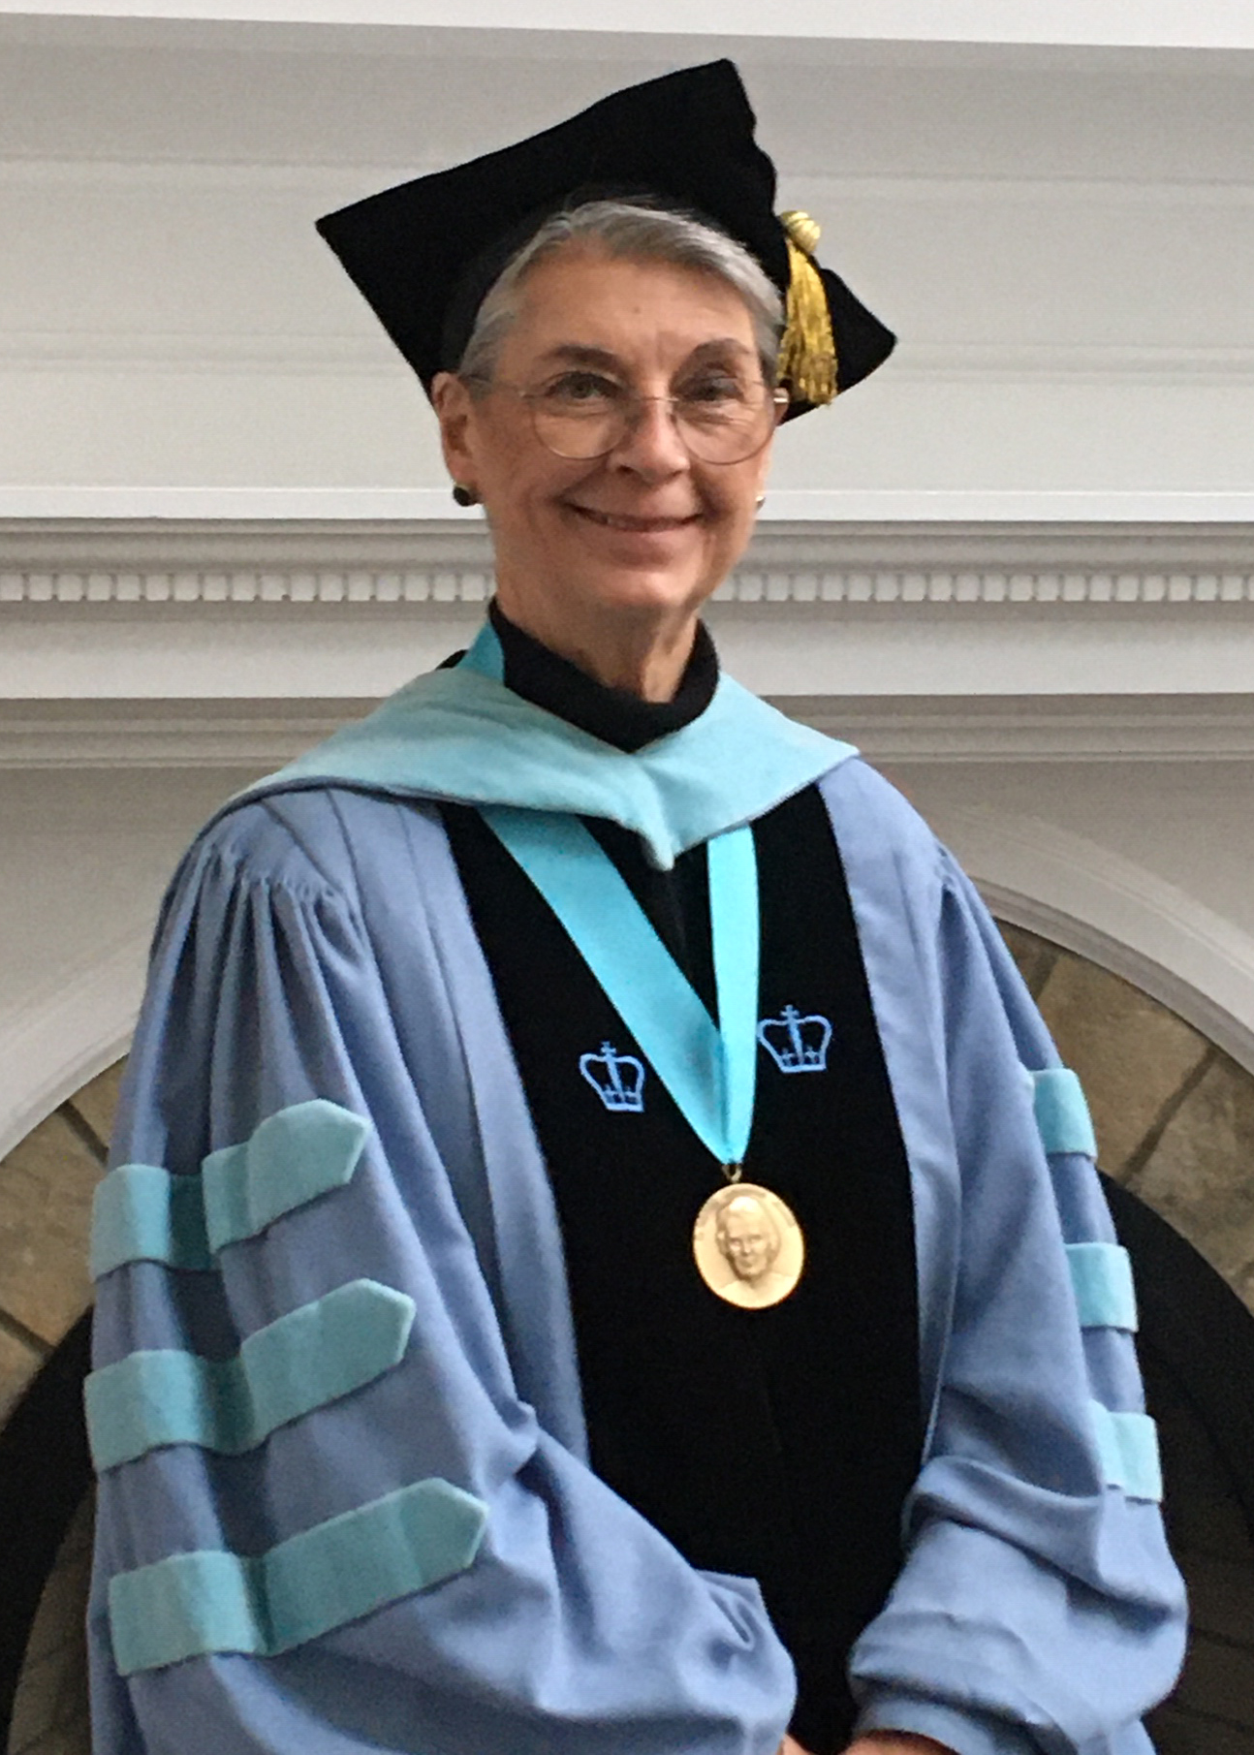
2020 McManus Medal Recipient

Slide 3
Learning Objectives
Propose changes in nursing education that reflect current research findings & are needed in order to prepare graduates for an uncertain, collaborative, ever-changing future
Examine the concept of excellence as it relates to nursing education
Describe the leadership skills needed by nurse educators to shape a preferred future for nursing education that is characterized by excellence

Slide 4
“The system in place in education
has displayed a remarkable ability
to take on the appearance of any
number of reforms without changing
in any substantial way …
“We have not yet learned the fundamental
lesson:
“No substantial change can occur in
education without a substantial change
in the thinking of educators.”
Paul, 1993

Slide 5
Substantial Changes in Thinking for Nurse Educators
Act as a leader … be creative … take risks
Expect & strive for excellence in ourselves, in others, & in the systems in which we function
Acknowledge the need for expertise in education … & reward it

Slide 6
What Changes Are Needed in Nursing Education?
How to best prepare graduates for an unknown future …

Slide 7
Changes Needed in All Aspects of the Academy
Engage in evidence-based teaching practices
Commit to developing the science of nursing education
Ensure that all faculty are prepared as educators … at least to some extent
Ensure that curricula are relevant, flexible, & evidence-based
Challenge students to THINK
Develop effective/meaningful interprofessional learning experiences
Attend more to broad social issues

Slide 8
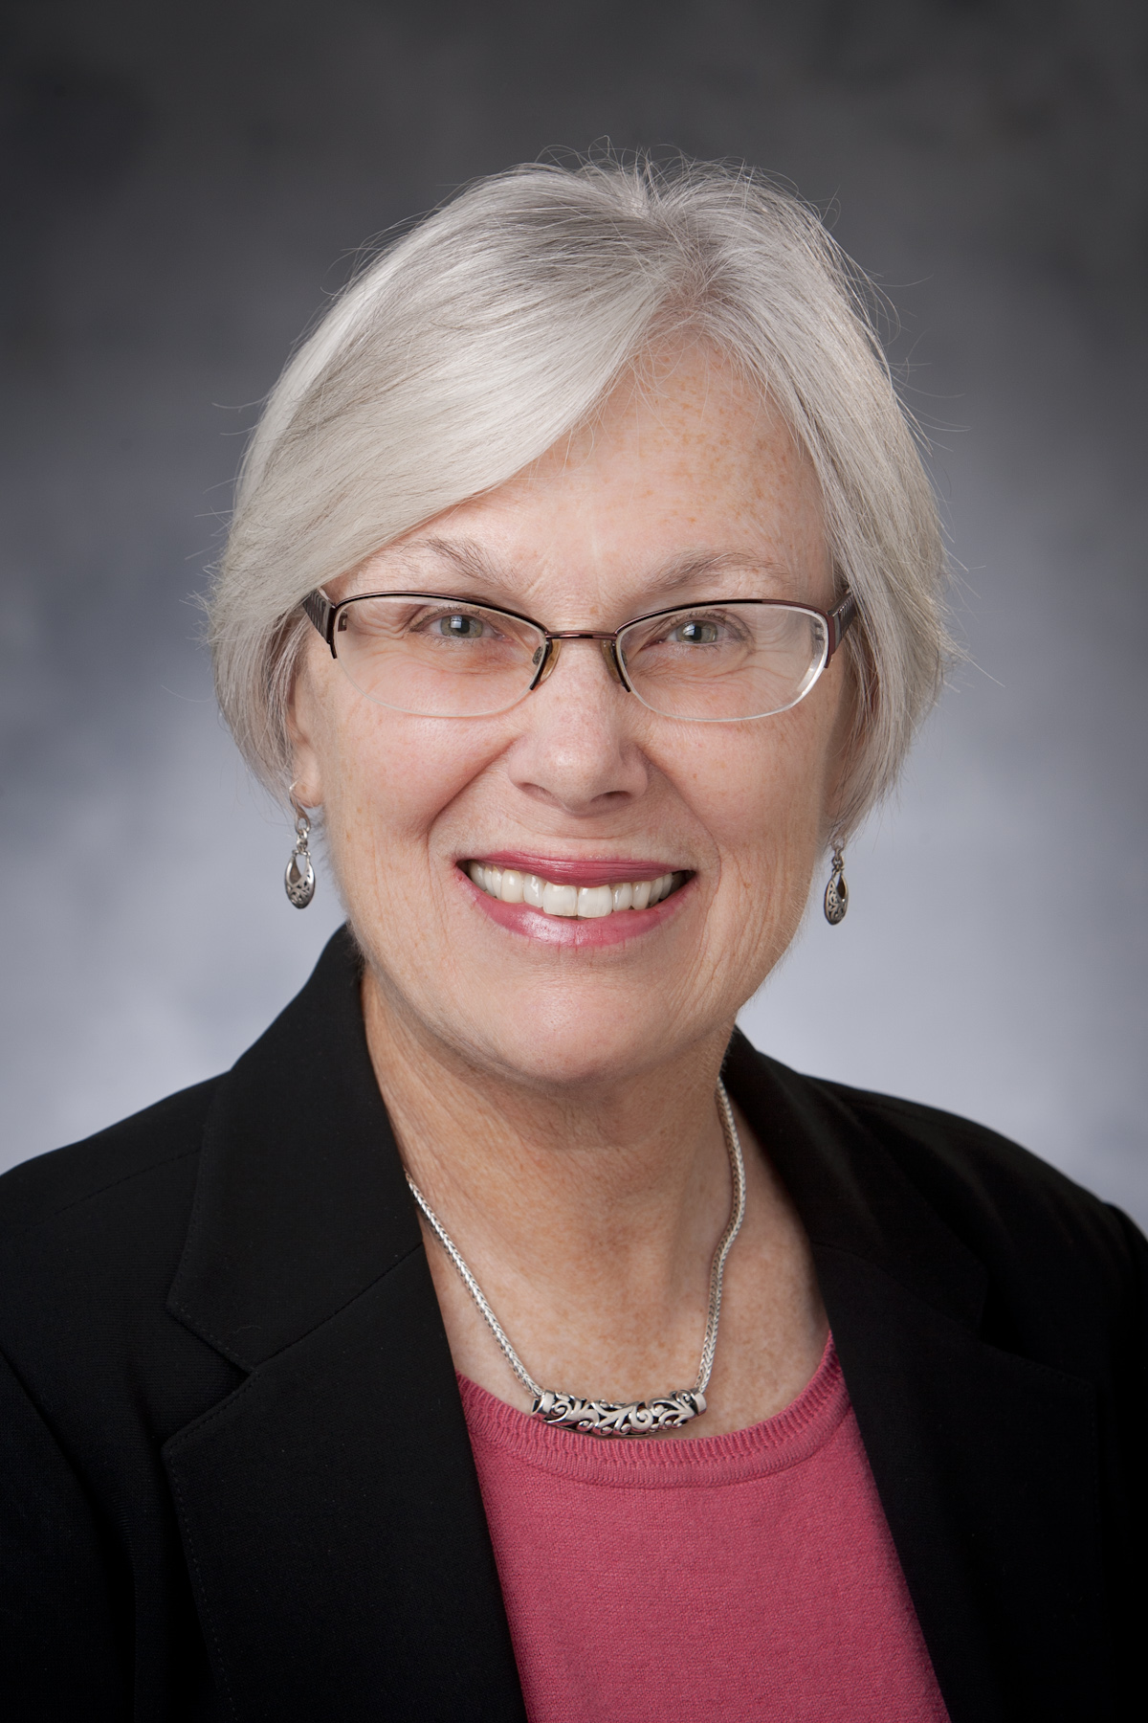
Evidence-based Teaching Practices & Science of Nursing Education
Marilyn Oermann
PhD, RN, ANEF, FAAN

Slide 9
Ensure that ALL Faculty are Prepared as Educators
Facilitate Learning
Facilitate Learner Development & Socialization … Identity Formation
Use Assessment & Evaluation Strategies
Participate in Curriculum Design & Evaluation of Program Outcomes
Function as a Change Agent & Leader
Pursue Continuous Quality Improvement in the Nurse Educator Role
Engage in Scholarship
Function within the Educational Environment
National League for Nursing, Nurse Educator Competencies
http://www.nln.org/professional-development-programs/competencies-for-nursing-education/nurse-educator-core-competency

Slide 10
Ensure that Curricula are Relevant, Flexible, & Evidence-based
Faculty preferences & “sacred cows” should not be the driving forces
  Do all students need to go through the curriculum in the same sequence?
  Do theory & clinical need to happen simultaneously?
  Do we offer enough elective experiences to meet students’ unique needs/interests?
Ensure that the “flow” of learning is logical/makes sense … explain that rationale to learners
Apply what we know about scaffolding, engagement of learners, the need for repetition of core ideas, how to manage increasing complexity, confidence-building, dealing with the “scariness “ of increasing independence, etc.

Slide 11
Challenge Students to THINK
Balance “challenge” & “support”
Implement the “art of questioning”
Encourage “radical candor” (Scott, K. 2019. Radical candor. St. Marten’s Press)
Stop giving all the answers
Expect students to provide “evidence” to support clinical decisions
Develop assignments that ”push” students to challenge – not merely report – the ideas of others

Slide 12
Develop Effective/Meaningful Interprofessional Experiences
Shared core courses … A & P, pharmacology concepts, health care system, etc.
Simulation experiences that truly highlight the important contributions of each member of the healthcare team
Collaborative on-site learning experiences
Assignments that challenge students to learn more about another profession
  Interview a pharmacist, member of the clergy, occupational therapist, etc. RE their preparation, the issues facing their profession, past experiences with nurses, etc.
  Be prepared to address same areas about nursing

Slide 13
Attend More to Social Issues
Poverty
Vulnerable populations
Community-based care & resources
Justice
Access to care
“Adopt” a neighborhood
Reduce time in acute care settings

Slide 14
New Skill Sets for All Healthcare Professionals (IOM, 2003)
Assessment & evaluation
Clinical decision-making
Intra- & Interprofessional collaboration
Communication
Diversity/Global perspective
Evidence-based practice
Healthcare economics
Information management
Innovation & creativity
Leadership & influence
Patient-centered care
Professional role
Safety & Quality … Patient advocacy
System-wide thinking
Tolerance for ambiguity/uncertainty
STRIVE FOR EXCELLENCE !!!

Slide 15
The Concept of
EXCELLENCE
The Goal for All Nurse Educators

Slide 16
Excellence
Setting high standards
Holding oneself to those standards
NOT being satisfied with anything less than the very best
NOT settling for …
  Second best
  Mediocre performance
  “Getting by”

Slide 17
“Success in America is quite easy to achieve … because so many are satisfied with mediocrity.”
Bob Huggins, NCAA

Slide 18
Hallmarks of Excellence in Nursing Education
Engaged Students
Diverse, Well-Prepared Faculty
A Culture of Continuous Quality Improvement
Innovative, Evidence-Based Curriculum
Innovative, Evidence-Based Approaches to Facilitate & Evaluate Learning
Resources to Support Program Goal Attainment
Commitment to Pedagogical Scholarship
Effective Institutional & Professional Leadership
National League for Nursing, 2020
http://www.nln.org/professional-development-programs/teaching-resources/hallmarks-of-excellence

Slide 19
What Might Excellence in Nursing Education Look Like?
Open, flexible curricula that are responsive to students’ learning needs
Lively exchange of ideas with students & teachers learning together
Open classrooms
Suggested learning goals & choice RE textbooks, assignments, etc.
Differences are encouraged
Emphasis on affective domain learning
Conversations address the uncertainty & ambiguity in our world
Measures other than NCLEX used to define quality in our programs

Slide 20
What Might It Look Like? (continued)
Excitement about learning & emphasis on it > on grades
Teachers think out loud & openly admit not knowing
Faculty see themselves (in their hearts) as EDUCATORS
Faculty make their thinking (& their struggles with difficult issues) visible to students
Faculty conduct pedagogical research & engage in evidence-based teaching
Teaching excellence & pedagogical scholarship are valued & rewarded
Faculty challenge students & expect great things from them

Slide 21
We don’t have to make human beings smart.
They are born smart.
All we need to do is STOP doing things that make them stupid.

Slide 22
Excellence then …
Is NOT tied to admission SAT scores
Is NOT tied to NCLEX pass rates
Is NOT tied to the many “sacred cows” we hold so dear
Is NOT tied to external funding amounts
Is NOT tied to faculty credentials
We ASSUME these things = Excellence …
Maybe it’s time to reflect on such “old” thinking

Slide 23
The Concept of
LEADERSHIP
Essential to Achieve EXCELLENCE

Slide 24
What Is LEADERSHIP ?
“Leadership is one of the most observed & least understood phenomena on earth” (James McGregor Burns)
“Leadership is about making others better as a result of your presence & making sure that impact lasts in your absence.” (Harvard Business School)
"Leadership is the capacity to create a compelling vision & translate it into action & sustain it. Successful leaders have a vision that other people believe in & treat as their own.“ (Warren Bennis)
“Leadership is the art & science of engaging people in envisioning & enabling the creation of a preferred future.” (Nancy Langston)

Slide 25





Exemplary Practices
Kouzes, J.M., & Posner, B.Z. (2017). The leadership challenge (6th ed.). John Wiley & Sons.

Slide 26
Tasks of Leaders
Grossman, S.C., & Valiga, T.M. (2021). The new leadership challenge:
Creating the future of nursing (6th ed.). F.A. Davis.
Envisioning Goals
Affirming Values
Representing the Group
Motivating
Managing
Explaining
Serving as a Symbol
Achieving a Workable Unity
Renewing
Original work:
Gardner, J. (1990). On leadership. Free Press.

Slide 27
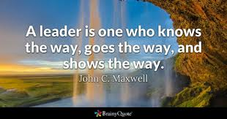
Leaders Are …
Oriented toward the future
“Societal architects”
Comprehensivists … “Gifted generalists”
Integrative thinkers
Educators & developers … Generative
Translators … Theory/Research → Action
Trustworthy
Credible … “The foundation of leadership” (Kouzes & Posner, pp. 25-44)
Ethical

Slide 28
What Leaders Do
Have a vision
Clearly articulate the vision
Inspire others to join in to make the vision a reality
Orchestrate change
Manage the “ups & downs”
Develop & renew followers

Slide 29
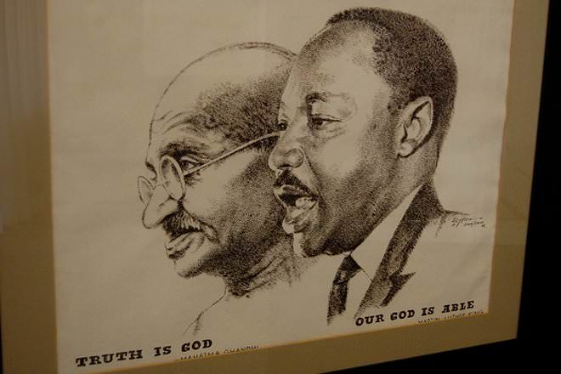
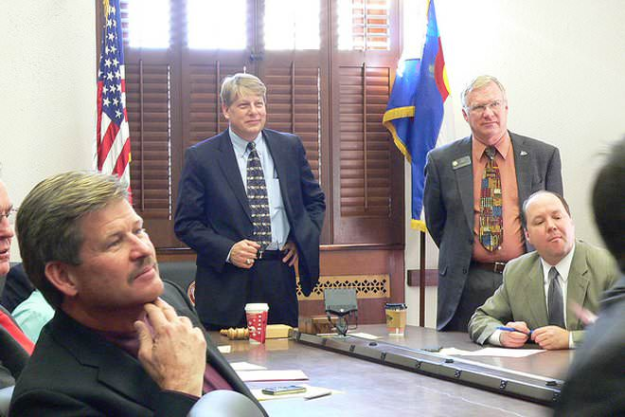
Leadership = Management
MANAGEMENT
LEADERSHIP

Slide 30
Leaders
Managers
Selected … or allowed by a group of followers
Power comes from knowledge, credibility, & ability to motivate followers
Vision/Goals arise from personal interests & passion … May differ from organization’s goals
Relative disorder seems to be generated
Appointed by someone in the organization’s hierarchy
Power arises from one’s legitimate position of authority
Vision/Goals espoused or prescribed by the organization
Rationality & control prevail

Slide 31
Leaders
Managers
Activities relate to vision
Freedom is extensive
Ideas are developed, tested, & encouraged among all members of the group
Activities relate to efficiency & cost-effectiveness
Freedom may be limited
Ideas are permitted … provided they do not interfere with task accomplishment

Slide 32
Leaders
Managers
Focus is on people
Perspective is long-rang … Eye on the horizon
Characterized by risk-taking, creativity, & innovation
Focus is on systems & structures
Perspective is short-range .. Eye on the bottom line
Low risk oriented, strives for balance, maintains the status quo

Slide 33
“Leaders do
things right.”
(Bennis & Nanus, 1985)
Leaders appeal to the
HEART
“Mangers do
the right things.”
(Bennis & Nanus, 1985)
Managers appeal to the
HEAD

Slide 34
Remember …
Not all managers
are leaders.
Not all leaders
are managers.

Slide 35
Closure
Take-Aways

Slide 36
Kairos … The “Right Moment”
A time of awakening
A time of radical changes
A time when reality embraces possibility
A time to author a radical new story
A time to create decidedly different minds

Slide 37
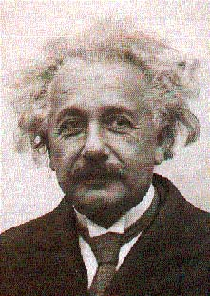
“The problems that exist in the world cannot be solved by the thinking that created them.”
Albert Einstein

Slide 38
Engage in New Conversations about Nursing Education
From these new conversations, new
dreams can be born, new stories can be
told, new maps can be created, & new
learning landscapes can be brought to life.
Marshall, S.P. (2006). The power to transform: Leadership that
brings learning and schooling to life (p. 179). Jossey-Bass.

Slide 39
To Shape the Future of Nursing Education, We Need …
Faculty who are EXPERTS in nursing education & who are willing to act as LEADERS every step of the way !!!
Deans/Directors who create systems that VALUE & REWARD expertise in nursing education & who are willing to act as TRUE LEADERS every step of the way !!!
“There is no greater force
for transformation than a
community that has
discovered who it is &
what it cherishes.”
Marshall, 2006, p. 197

Slide 40
Learning Objectives
Propose changes in nursing education that reflect current research findings & are needed in order to prepare graduates for an uncertain, collaborative, ever-changing future
Examine the concept of excellence as it relates to nursing education
Describe the leadership skills needed by nurse educators to shape a preferred future for nursing education that is characterized by excellence

Slide 41
Thank You !!!

